Slide 1

NoSQL databases
What is NoSQL?
A non-relational database, i.e., one which does not use tables for storing data.
NoSQL databases are used mainly to work with Big Data and real-time web apps.
There are multiple types of NoSQL databases(Document-based such as MongoDB, Key-Value Stores, Column based store etc.)

Slide 2








NoSQL
Key-value
Graph database
Document-oriented
Column family

Slide 3
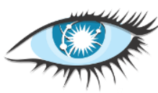
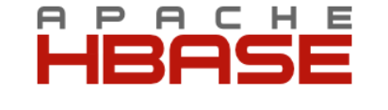
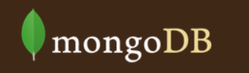
Common NoSQL Databases
  Cassandra
    Industry leading, ultra scalable
  HBase
    Database built on top of Hadoop and HDFS
  MongoDB
    JSON- database with dynamic schema
Lizy K. John
3/1/2014

Slide 4
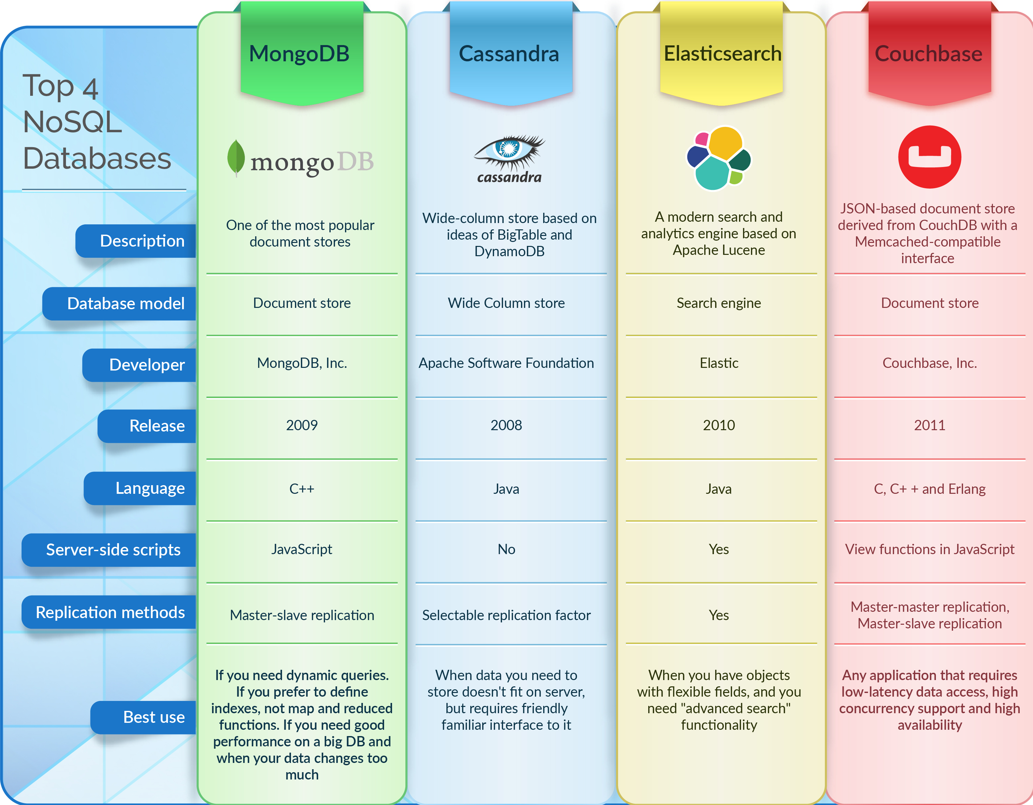

Slide 5
References

